Slide 1
SI671/721
Discussion 5
Time series

Slide 2
Edit Distance Example
 |  | a | b | d
 | 0 | 1 | 2 | 3
c | 1 | 1 | 2 | 3
a | 2 | 1 | 2 | 3
b | 3 | 2 | 1 | 2

Slide 3
What is time series analysis?
“Time series analysis comprises methods for analyzing time series data in order to extract meaningful statistics and other characteristics of the data. Time series forecasting is the use of a model to predict future values based on previously observed values. ”

Slide 4
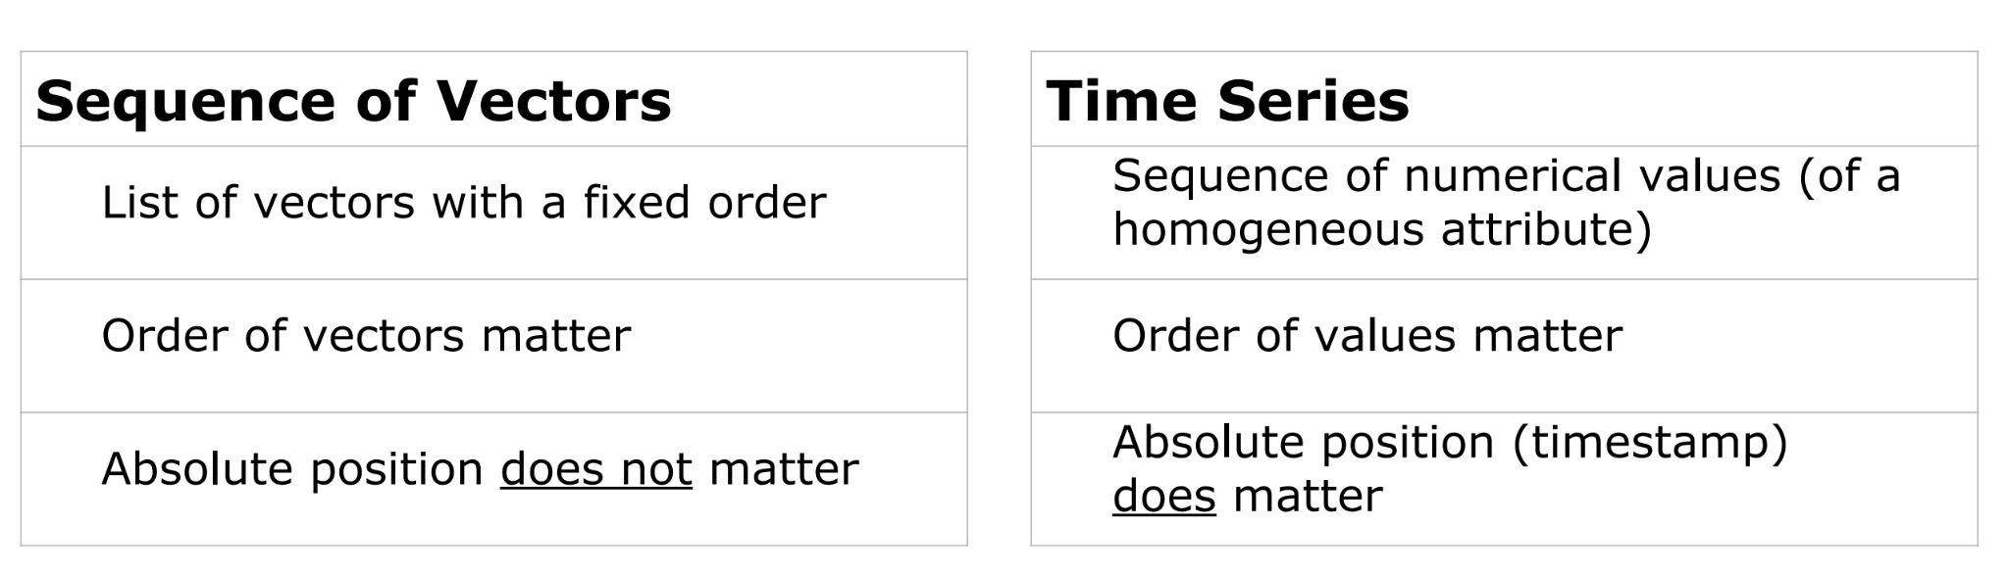



Slide 5
Application
Stock Market
Sale forecasting
Notes:
Reviewing the existing literature, it can be found that time series clustering essentially consists of 4 steps.
1. feature extraction (human extraction OR model extraction (REPRESENTATION) are both a method of feature extraction);
2. distance metric:
3.prototype
4.result evaluation.

Slide 6
Outline
Seasonal and Trend decomposition
Check this link https://otexts.com/fpp3/decomposition.html if you are very interested in time series and want to learn more than this course.
Fitting a Trend Curve
Weighted Moving Average
"Time" Exponential Moving Average (EMA)
Notes:
LSTM
Transformer
Informer: https://github.com/zhouhaoyi/Informer2020

Slide 7
STL= Seasonal and Trend decomposition using Loess
y(t)=S(t)+T(t)+R(t)
Or
y(t)=S(t)×T(t)×R(t)
Or
…. Log
Many other decomposition formula
S(t) = seasonal component -> seasonal
T(t) = trend-cycle component -> trend
R(t) = the rest -> something else
Notes:
- additive/multiplicative model
- LOESS (locally estimated scatterplot smoothing)

Slide 8
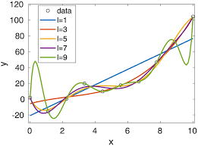
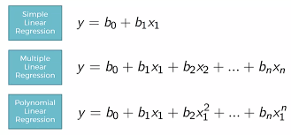
Fitting a Trend Curve
polynomial regression

Slide 9
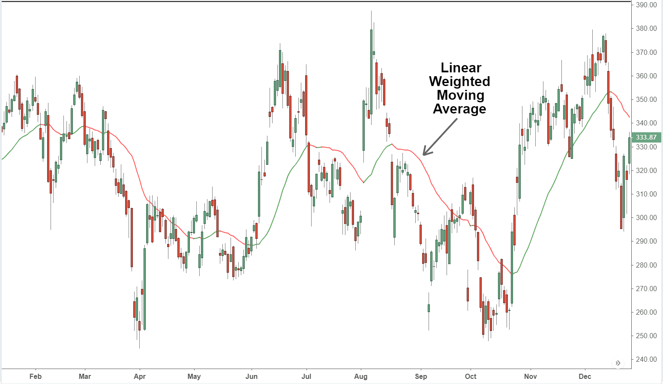
Moving Average
Notes:
Eliminate shot-term fluctuations
Identify the overall trend of the market

Slide 10
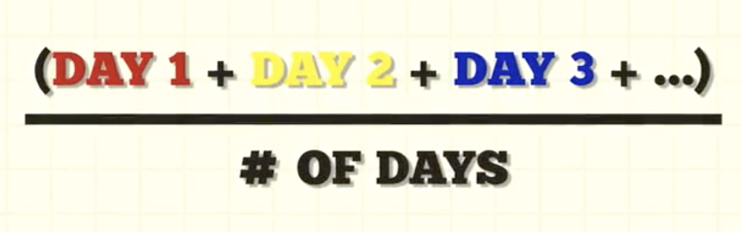
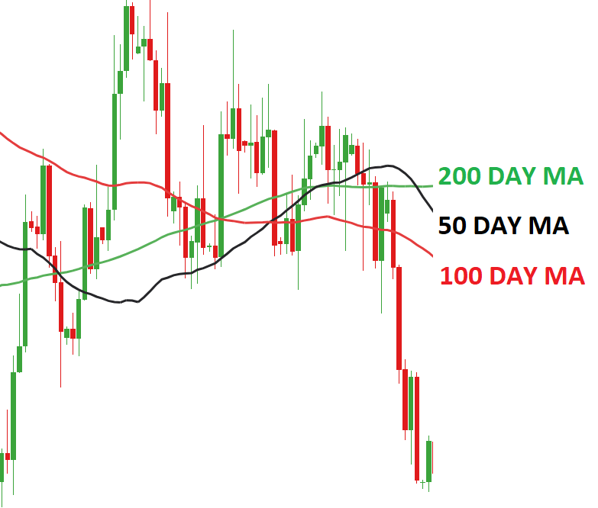
Simple Moving Average

Slide 11
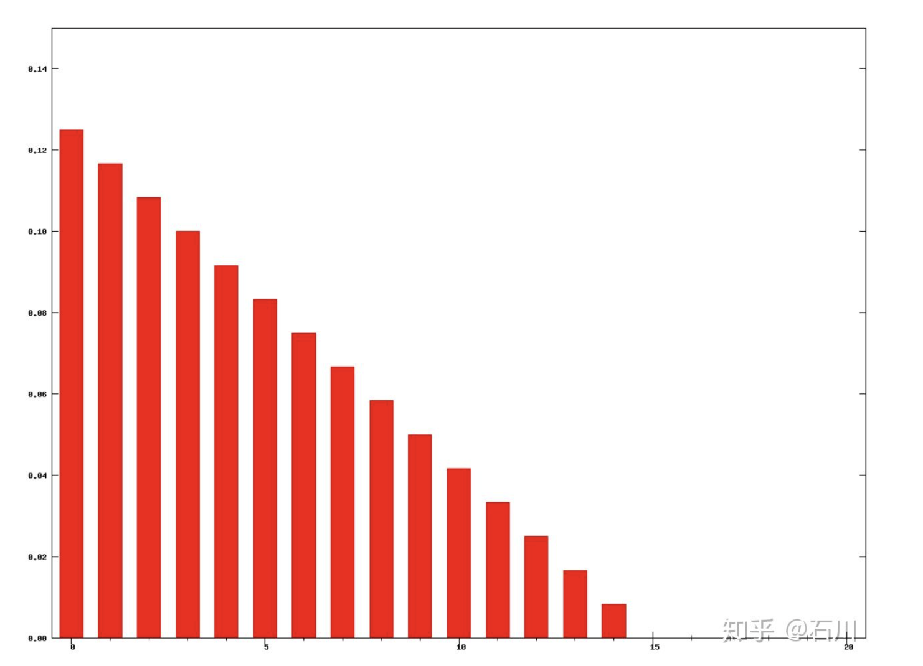
Moving Average
Idea: treat recent data more relevant
Weighting relationship of recent day and past day is linear

Slide 12
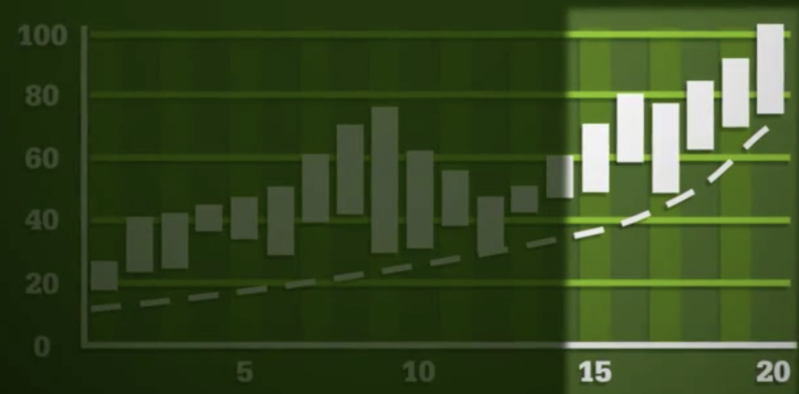
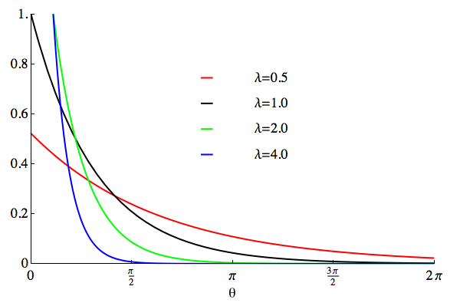
"Time" Exponential Moving Average (EMA)
Idea: treat recent data more relevant
Weighting relationship of recent day and past day is exponential
No need to set windows

